Slide 1
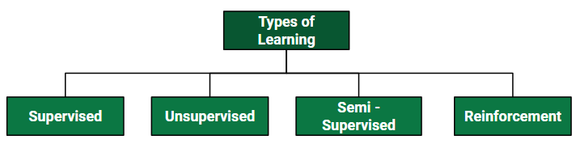
Types of Learning

Slide 2
ML algorithm List
DBSCAN Clustering
Naive Bayes
Gradient Boosting (Used in implementing the Instagram Algorithm)
Logistic Regression
Linear Regression
Apriori Algorithm
K Nearest Neighbor
CatBoost
SMOTE
Hypothesis Testing (Commonly used in Outlier Detection)
Tf-Idf Vectorization
Cross-Validation
4 Graph Algorithms (Connected Components, Shortest Path, Pagerank, Centrality Measures)
Ridge and Lasso Regression
Notes:
https://www.datacamp.com/tutorial/decision-tree-classification-python

Slide 3
ML algorithm List
StandardScaler
SARIMA
ARIMA
XGBoost Algorithm
Long Short Term Memory (LSTM)
One Hot Encoding
Bidirectional Encoder Representations from Transformers (BERT)
Facebook Prophet
NeuralProphet
AdaBoost Algorithm
Random Forest Algorithm
H2O AutoML
Polynomial Regression
Gradient Descent Algorithm
Grid Search Algorithm
K-Means Algorithm

Slide 4
ML Algorithm List
Manifold Learning
Principal Component Analysis
Decision Trees
Support Vector Machines
Neural Networks
FastAI
LightGBM

Slide 5
Different Models of Supervised Learning

Slide 6
Outline
Different Models of Supervised Learning
Linear Regression:
Logistic Regression:
Decision Trees:
Random Forests:
Support Vector Machine(SVM)
K-Nearest Neighbors (KNN)
Gradient Boosting

Slide 7
Decision Tree Overview
Decision Tree is a Supervised learning technique that can be used for both classification and Regression problems, but mostly it is preferred for solving Classification problems.
It is a tree-structured classifier, where internal nodes represent the features of a dataset, branches represent the decision rules and each leaf node represents the outcome.
In a Decision tree, there are two nodes, which are the Decision Node and Leaf Node. Decision nodes are used to make any decision and have multiple branches, whereas Leaf nodes are the output of those decisions and do not contain any further branches.

Slide 8
Overview
The decisions or the test are performed on the basis of features of the given dataset.
It is a graphical representation for getting all the possible solutions to a problem/decision based on given conditions.
It is called a decision tree because, similar to a tree, it starts with the root node, which expands on further branches and constructs a tree-like structure.
In order to build a tree, we use the CART algorithm, which stands for Classification and Regression Tree algorithm.
A decision tree simply asks a question, and based on the answer (Yes/No), it further split the tree into subtrees.

Slide 9
The Decision Tree Algorithm
A decision tree is a flowchart-like tree structure where an internal node represents a feature(or attribute), the branch represents a decision rule, and each leaf node represents the outcome.
The topmost node in a decision tree is known as the root node.
It learns to partition on the basis of the attribute value.
It partitions the tree in a recursive manner called recursive partitioning. This flowchart-like structure helps you in decision-making. It's visualization like a flowchart diagram which easily mimics the human level thinking. That is why decision trees are easy to understand and interpret.

Slide 10

Entropy
Entropy: Entropy is the measure of uncertainty or randomness in a data set. Entropy handles how a decision tree splits the data.
It is calculated using the following formula:

Slide 11
Information Gain
Gini Index:
The information gain measures the decrease in entropy after the data set is split.
It is calculated as follows:
IG( Y, X) = Entropy (Y) - Entropy ( Y | X)
The Gini Index is used to determine the correct variable for splitting nodes. It measures how often a randomly chosen variable would be incorrectly identified.

Slide 12
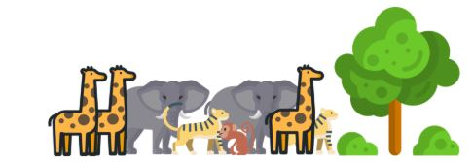
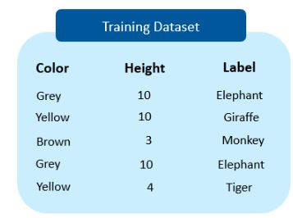
Decision Tree Algorithm Work
We have to determine which features split the data so that the information gain is the highest. We can do that by splitting the data using each feature & checking the information gain that we obtain from them.
The feature that returns the highest gain will be used for the 1st split

Slide 13
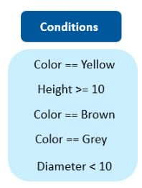
We’ll use the information gain method to determine which variable yields the maximum gain, which can also be used as the root node

Slide 14
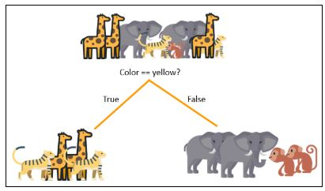
Suppose ”Color == Yellow” results in the maximum information gain, so that is what we will use for our first split at the root node
The entropy after splitting should decrease considerably.
However, we still need to split the child nodes at both the branches to attain an entropy value equal to zero

Slide 15
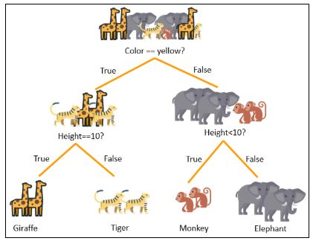
We will split both the nodes using ‘height’ variable and height > 10 and height < 10 as our conditions.

Slide 16
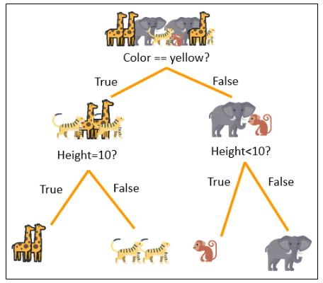
The decision tree can now predict all the classes of animals present in the data set. Now, it’s time to build a prediction model using the decision tree in Python.

Slide 17
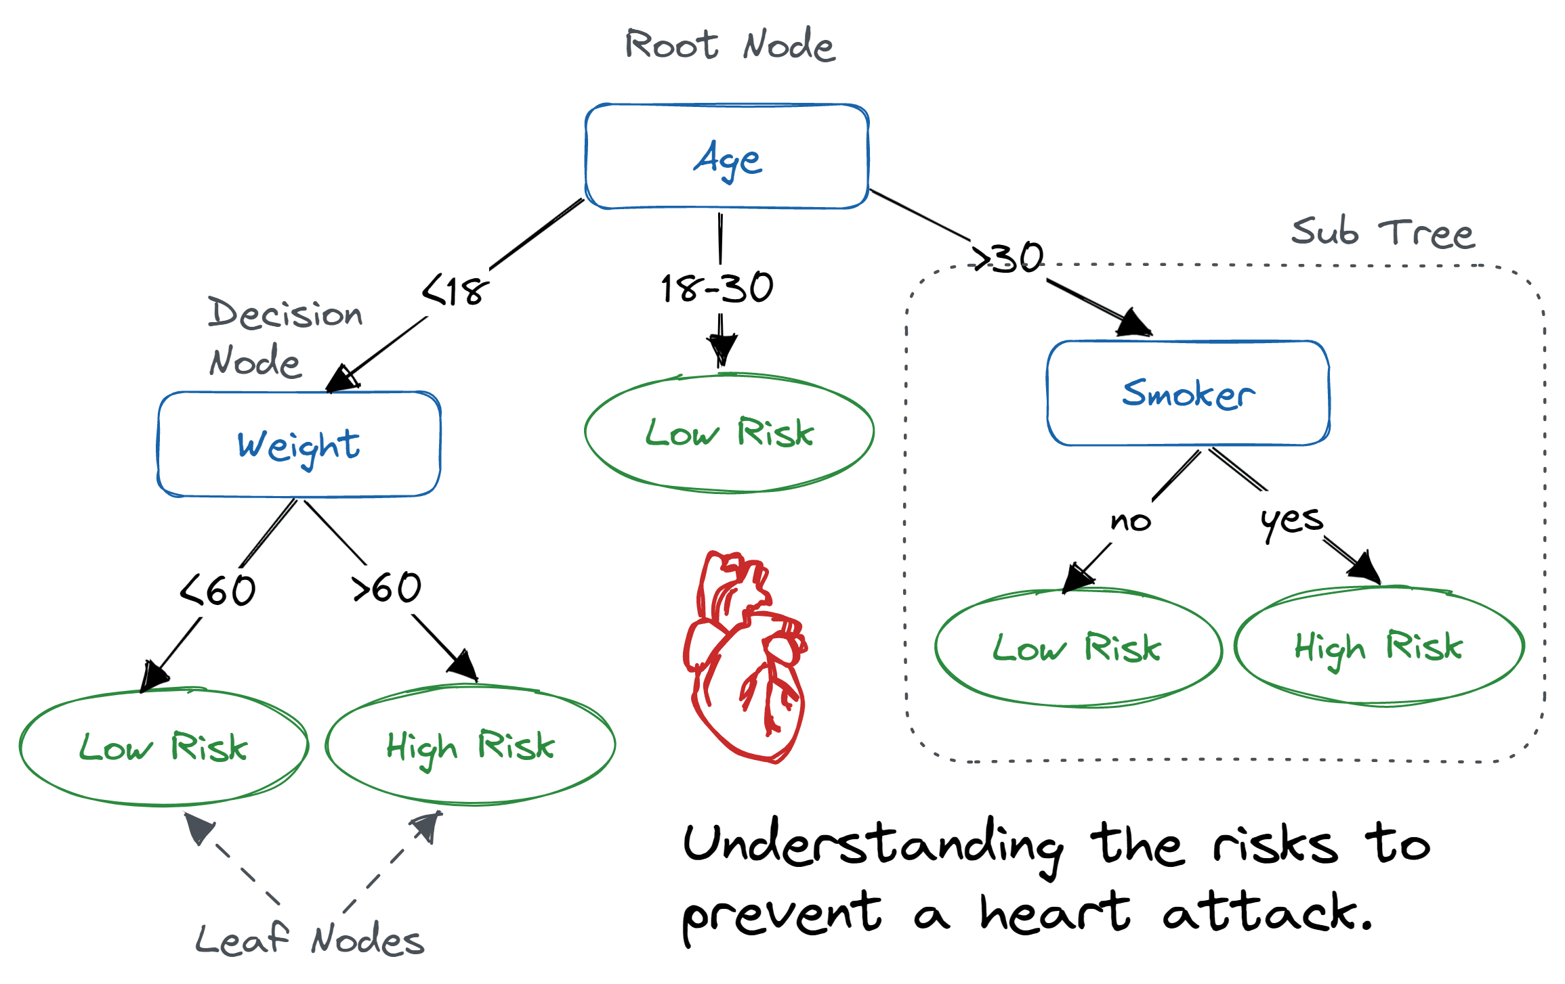

Slide 18
How Does the Decision Tree Algorithm Work?
YouTube video :https://www.youtube.com/watch?v=LDRbO9a6XPU
The basic idea behind any decision tree algorithm is as follows:
Select the best attribute using Attribute Selection Measures (ASM) to split the records.
Make that attribute a decision node and breaks the dataset into smaller subsets.
Start tree building by repeating this process recursively for each child until one of the conditions will match:
All the tuples belong to the same attribute value.
There are no more remaining attributes.
There are no more instances.
Notes:
https://www.datacamp.com/tutorial/decision-tree-classification-python

Slide 19
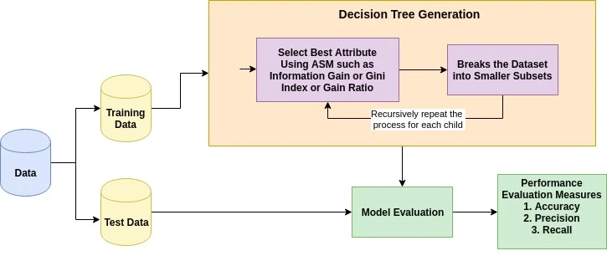

Slide 20
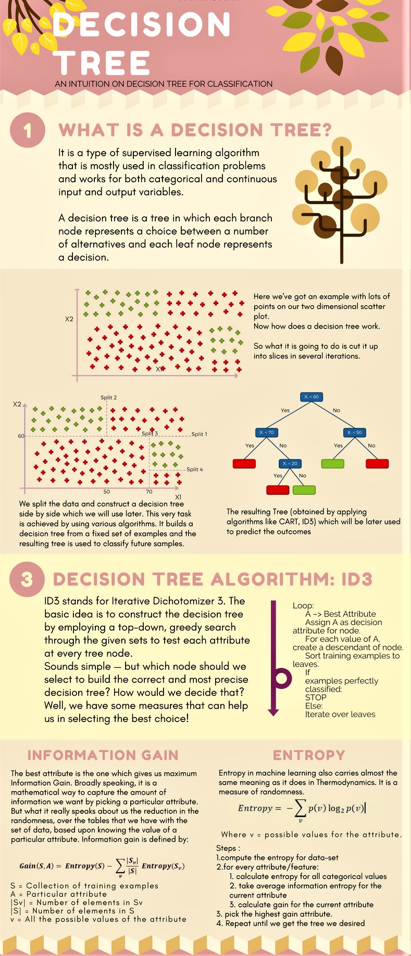

Slide 24
Logistic Regression in Machine Learning
Supervised Learning technique. It is used for predicting the categorical dependent variable using a given set of independent variables.
Logistic regression predicts the output of a categorical dependent variable. Therefore the outcome must be a categorical or discrete value. It can be either Yes or No, 0 or 1, true or False, etc. but instead of giving the exact value as 0 and 1, it gives the probabilistic values which lie between 0 and 1.
Logistic Regression is much similar to the Linear Regression except that how they are used. Linear Regression is used for solving Regression problems, whereas Logistic regression is used for solving the classification problems.
In Logistic regression, instead of fitting a regression line, we fit an "S" shaped logistic function, which predicts two maximum values (0 or 1).

Slide 25
Linear Regression
What is Linear Regression?
It is a type of statistical analysis used to predict the relationship between two variables.
It assumes a linear relationship between the independent variable and the dependent variable, and aims to find the best-fitting line that describes the relationship.
The line is determined by minimizing the sum of the squared differences between the predicted values and the actual values.
Linear regression application:
Linear regression is commonly used in many fields, including economics, finance, and social sciences, to analyze and predict trends in data.
It can also be extended to multiple linear regression, where there are multiple independent variables, and logistic regression, which is used for binary classification problems.

Slide 26
Simple Linear Regression
Simple Linear Regression
In a simple linear regression, there is one independent variable and one dependent variable. The model estimates the slope and intercept of the line of best fit, which represents the relationship between the variables.
The slope represents the change in the dependent variable for each unit change in the independent variable, while the intercept represents the predicted value of the dependent variable when the independent variable is zero.
Linear regression is a quiet and the simplest statistical regression method used for predictive analysis in machine learning.
Linear regression shows the linear relationship between the independent(predictor) variable i.e. X-axis and the dependent(output) variable i.e. Y-axis, called linear regression. If there is a single input variable X(independent variable), such linear regression is called simple linear regression.

Slide 27
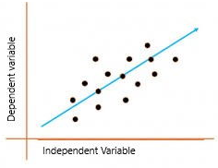
Simple Linear Regression
The graph presents the linear relationship between the output(y) and predictor(X) variables. The blue line is referred to as the best-fit straight line. Based on the given data points, we attempt to plot a line that fits the points the best.
To calculate best-fit line linear regression uses a traditional slope-intercept form which is given below,
Y_{i} = β₀ + β₁X_{i}
where Y_{i} = Dependent variable, β₀ = constant/Intercept, β₁ = Slope/Intercept, X_{i} = Independent variable.

Slide 28
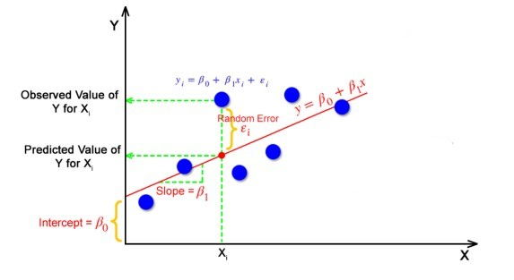
This algorithm explains the linear relationship between the dependent(output) variable y and the independent(predictor) variable X using a straight line Y= B₀ + B₁ X.
But how the linear regression finds out which is the best fit line?
The goal of the linear regression algorithm is to get the best values for B₀ and B₁ to find the best fit line. The best fit line is a line that has the least error which means the error between predicted values and actual values should be minimum.

Slide 29
Random Error(Residuals)
In regression, the difference between the observed value of the dependent variable(y_{i}) and the predicted value(predicted) is called the residuals.
ε_{i} = y_{predicted} – y_{i}
where y_{predicted} = B₀ + B₁ X_{i}
The Best fit line is a line that fits the given scatter plot in the best way. Mathematically, the best fit line is obtained by minimizing the Residual Sum of Squares(RSS).
Cost Function
The least Sum of Squares of Errors is used as the cost function for Linear Regression.
For all possible lines, calculate the sum of squares of errors. The line which has the least sum of squares of errors is the best fit line.

Slide 30
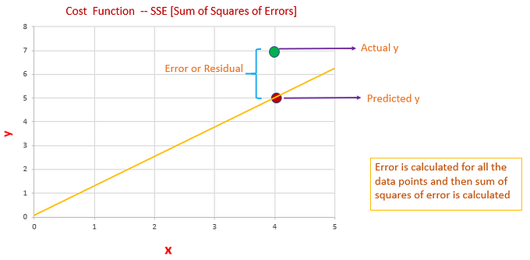

Slide 31
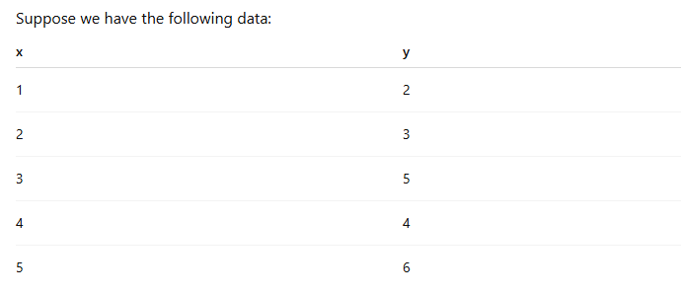
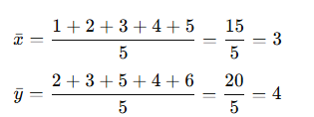
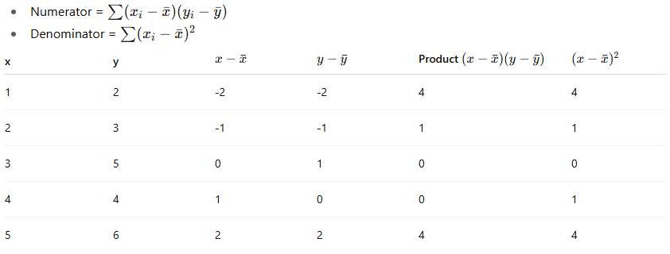
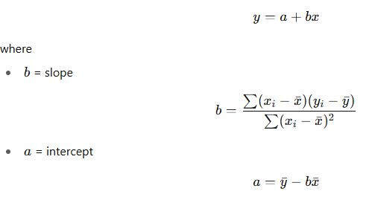
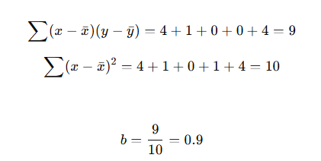

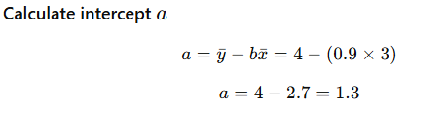
Best Fit Line

Slide 32
Two Independent Variables
Two independent variable
A regression with two independent variables such as the example discussed above will produce a formula with this basic structure: y= c + b1(x1) + b2(x2)
In this equation, y is the dependent variable, c is a constant, b1 is the first regression coefficient and x1 is the first independent variable. The second coefficient and second independent variable are b2 and x2, respectively. Drawing from the above example, the stock price would be y, the S&P 500 would be x1 and the unemployment rate would be x2. The coefficient of each independent variable represents the degree of change in y for each additional unit in that variable.
If the S&P 500 increases by one, the resulting y or share price will go up by the amount of the coefficient. The same is true for the second independent variable, the unemployment rate. In a simple regression with one independent variable, that coefficient is the slope of the line of best fit. In this example or any regression with two independent variables, the slope is a mix of the two coefficients. The constant c is the y-intercept of the line of best fit.

Slide 33
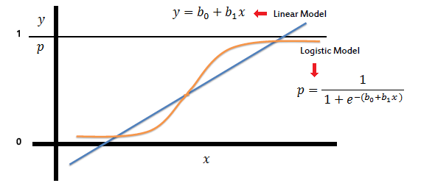
In logistic regression the constant (b₀) moves the curve left and right and the slope (b₁) defines the steepness
of the curve. By simple transformation, logistic regression equation can be written in terms of an odds ratio.
LOGISTIC REGRESSION PRODUCES A LOGISTIC CURVE, WHICH IS LIMITED TO VALUES BETWEEN 0 & 1.
LOGISTIC REGRESSION IS SIMILAR TO A LINEAR REGRESSION, BUT THE CURVE IS CONSTRUCTED USING THE NATURAL LOGARITHM OF THE “ODDS” OF THE TARGET VARIABLE, RATHER THAN THE PROBABILITY.
MOREOVER, THE PREDICTORS DO NOT HAVE TO BE NORMALLY DISTRIBUTED OR HAVE EQUAL VARIANCE IN EACH GROUP.
Notes:
https://saedsayad.com/logistic_regression.html
Doubt in last line

Slide 34
The curve from the logistic function indicates the likelihood of something such as whether the cells are cancerous or not, a mouse is obese or not based on its weight, etc.
Logistic Regression is a significant machine learning algorithm because it has the ability to provide probabilities and classify new data using continuous and discrete datasets.
Some examples of such classifications and instances where the binary response is expected or implied are:
1. Determine the probability of heart attacks: With the help of a logistic model, medical practitioners can determine the relationship between variables such as the weight, exercise, etc., of an individual and use it to predict whether the person will suffer from a heart attack or any other medical complication.
2. Possibility of enrolling into a university: Application aggregators can determine the probability of a student getting accepted to a particular university or a degree course in a college by studying the relationship between the estimator variables, such as GRE, GMAT, or TOEFL scores.
3. Identifying spam emails: Email inboxes are filtered to determine if the email communication is promotional/spam by understanding the predictor variables and applying a logistic regression algorithm to check its authenticity.

Slide 35
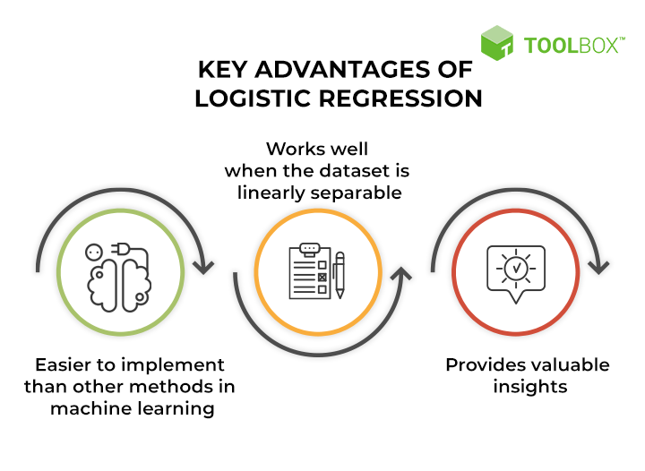
Key advantages of logistic regression

Slide 36
Logistic Regression Equation and Assumptions
Logistic Regression Equation and Assumptions
Logistic regression uses a logistic function called a sigmoid function to map predictions and their probabilities. The sigmoid function refers to an S-shaped curve that converts any real value to a range between 0 and 1.
Moreover, if the output of the sigmoid function (estimated probability) is greater than a predefined threshold on the graph, the model predicts that the instance belongs to that class. If the estimated probability is less than the predefined threshold, the model predicts that the instance does not belong to the class.
For example, if the output of the sigmoid function is above 0.5, the output is considered as 1. On the other hand, if the output is less than 0.5, the output is classified as 0. Also, if the graph goes further to the negative end, the predicted value of y will be 0 and vice versa. In other words, if the output of the sigmoid function is 0.65, it implies that there are 65% chances of the event occurring; a coin toss, for example.

Slide 37

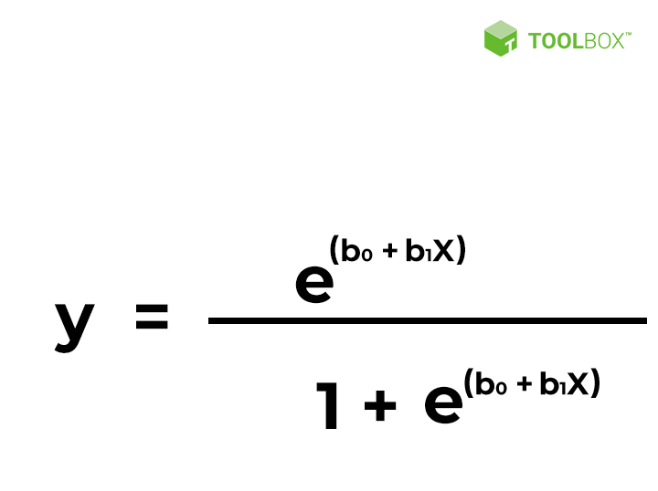
The sigmoid function is referred to as an activation function for logistic regression & is defined as:
e = base of natural logarithms
value = numerical value one wishes to transform
x = input value | y = predicted output
b0 = bias or intercept term
b1 = coefficient for input (x)
This equation is similar to linear regression, where the input values are combined linearly to predict an output value
using weights or coefficient values.
However, unlike linear regression, the output value modeled here is a binary value (0 or 1) rather than a numeric value.

Slide 38
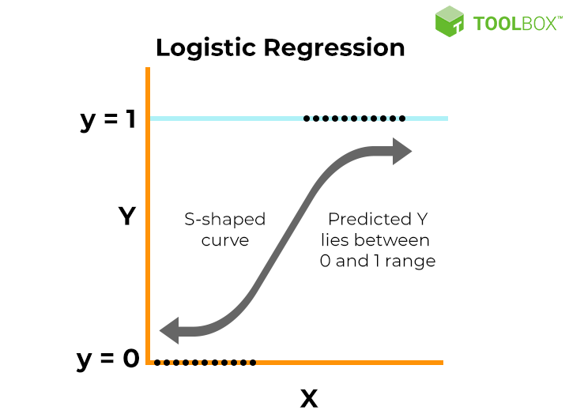

Slide 39
Key properties of the logistic regression equation
Logistic regression’s dependent variable obeys ‘Bernoulli distribution’ (0 & 1)
Estimation/prediction is based on ‘maximum likelihood.’
Logistic regression does not evaluate the coefficient of determination (or R squared) as observed in linear regression’. Instead, the model’s fitness is assessed through a concordance.
Maximum likelihood | Model chooses the curve that fits the data best.
No R²; use concordance | Measures how well model distinguishes 0s from 1s.

Slide 40
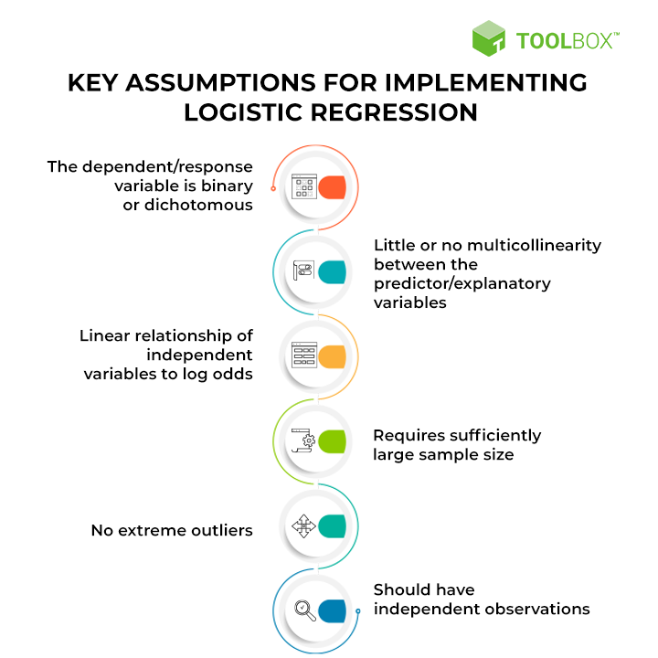

Slide 41
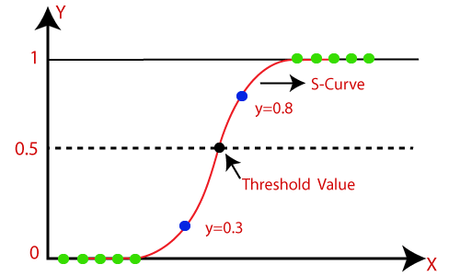
Logistic Regression in Machine Learning
Logistic Regression can be used to classify the observations using different types of data and can easily determine the most effective variables used for the classification. The below image is showing the logistic function:

Slide 42
Logistic Regression in Machine Learning
Logistic regression uses the concept of predictive modeling as regression; therefore, it is called logistic regression, but is used to classify samples; Therefore, it falls under the classification algorithm.
Sigmoid function is a mathematical function used to map the predicted values to probabilities. It maps any real value into another value within a range of 0 and 1.
The value of the logistic regression must be between 0 and 1, which cannot go beyond this limit, so it forms a curve like the "S" form. The S-form curve is called the Sigmoid function or the logistic function.

Slide 43
Assumptions for Logistic Regression
Assumptions for Logistic Regression:
The dependent variable must be categorical in nature.
The independent variable should not have multi-collinearity.
Multicollinearity is a statistical concept where several independent variables in a model are correlated. Two variables are considered perfectly collinear if their correlation coefficient is +/- 1.0. Multicollinearity among independent variables will result in less reliable statistical inferences
Logistic Regression Equation: Can be obtained from the Linear Regression equation. The mathematical steps to get Logistic Regression equations are given below:
We know the equation of the straight line can be written as:
Notes:
1. The dependent variable must be categorical
Logistic regression is used when the outcome is Yes/No, 0/1, Spam/Not Spam, etc.
It cannot predict continuous values like height or salary.
2. The independent variables should not have multicollinearity
Your input features (X1, X2, X3…) should not be highly correlated with each other.
If two variables give almost the same information, the model gets confused.
It means two or more independent variables move together too closely.
Correlation ±1 = perfect multicollinearity (worst case).
Result: the model becomes unstable, and predictions become less reliable.
3. Logistic Regression Equation (simple idea)
Start with the linear regression equation: y = b₀ + b₁x
But logistic regression can't use this directly because the output must be 0–1 probability.
So we apply a logistic (sigmoid) function to squeeze the output between 0 and 1:
p=11+e−(b0+b1x)p = \frac{1}{1 + e^{-(b_0 + b_1x)}}p=1+e−(b0​+b1​x)1​
This converts the linear line into an S-shaped curve suitable for classification.

Slide 44



Assumptions for Logistic Regression
In Logistic Regression y can be between 0 and 1 only, so for this let's divide the above equation by (1-y):
But we need range between -[infinity] to +[infinity], then take logarithm of the equation it will become:

Slide 45
Type of Logistic Regression
Type of Logistic Regression:
On the basis of the categories, Logistic Regression can be classified into three types:
Binomial: In binomial Logistic regression, there can be only two possible types of the dependent variables, such as 0 or 1, Pass or Fail, etc.
Multinomial: In multinomial Logistic regression, there can be 3 or more possible unordered types of the dependent variable, such as "cat", "dogs", or "sheep"
Ordinal: In ordinal Logistic regression, there can be 3 or more possible ordered types of dependent variables, such as "low", "Medium", or "High".
Notes:
https://www.javatpoint.com/logistic-regression-in-machine-learning

Slide 46
K-Nearest Neighbor(KNN) Algorithm for ML
Simplest Machine Learning algorithms based on Supervised Learning technique.
K-NN algorithm assumes the similarity between the new case/data and available cases and put the new case into the category that is most similar to the available categories.
K-NN algorithm stores all the available data and classifies a new data point based on the similarity. This means when new data appears then it can be easily classified into a well suite category by using K- NN algorithm.
K-NN algorithm can be used for Regression as well as for Classification but mostly it is used for the Classification problems.
K-NN is a non-parametric algorithm, which means it does not make any assumption on underlying data.

Slide 47
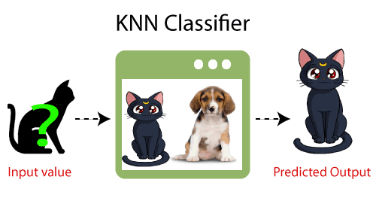
K-Nearest Neighbor(KNN) Algorithm for ML
It is also called a lazy learner algorithm because it does not learn from the training set immediately instead it stores the dataset and at the time of classification, it performs an action on the dataset.
KNN algorithm at the training phase just stores the dataset and when it gets new data, then it classifies that data into a category that is much similar to the new data.
Example: Suppose, we have an image of a creature that looks similar to cat and dog, but we want to know either it is a cat or dog. So for this identification, we can use the KNN algorithm, as it works on a similarity measure. Our KNN model will find the similar features of the new data set to the cats and dogs images and based on the most similar features it will put it in either cat or dog category.

Slide 48
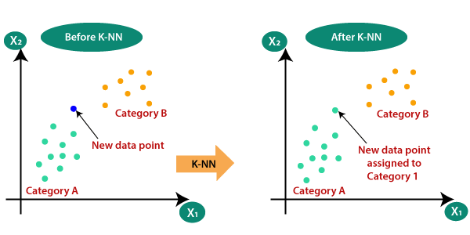
K-Nearest Neighbor(KNN) Algorithm for ML
Note that KNN isn’t the best choice for extremely large datasets. This is because the time complexity (Big O) of this algorithm is exponential.
Suppose there are two categories, i.e., Category A and Category B, and we have a new data point x1, so this data point will lie in which of these categories. To solve this type of problem, we need a K-NN algorithm. With the help of K-NN, we can easily identify the category or class of a particular dataset. Consider the below diagram:

Slide 49
How does K-NN works?
How does K-NN work
Step-1: Select the number K of the neighbors
Step-2: Calculate the Euclidean distance of K number of neighbors
Step-3: Take the K nearest neighbors as per the calculated Euclidean distance.
Step-4: Among these k neighbors, count the number of the data points in each category.
Step-5: Assign the new data points to that category for which the number of the neighbor is maximum.
Step-6: Our model is ready.

Slide 50
Best K selection
There are no pre-defined statistical methods to find the best value of K in the K-nearest neighbors (KNN) algorithm. However, you can try these methods:
Square root method: Take the square root of the number of samples in the training dataset.
Cross validation method: Use cross validation to find the optimal value of K.
Error plot or accuracy plot: Use an error plot or accuracy plot to find the most favorable K value. Plot K vs Error or K vs Accuracy -> Choose the K where the error is minimum or accuracy is maximum.
Mean Error Rate: Try a range of K values -> Calculate mean error for each -> Choose the K with the lowest mean error.
Take a range of values of k and calculate the mean error rate of all these Ks.
Notes:
1. K should not be too small
If K = 1 or 2, the model becomes too sensitive.
One noisy point can mislead the prediction.
This causes overfitting (model memorizes noise).
2. K should not be too large
If K is very big, it mixes many different categories.
Unique patterns get ignored.
This causes underfitting (model becomes too simple).
3. Most common practical choice: K = √N
N = total data points
Example: If you have 400 samples → K = √400 = 20
4. Try multiple K values and pick the best (Cross-Validation)
Test different K values (3, 5, 7, 9…).
Choose the one with minimum error.
5. K should be odd for classification
Prevents ties between classes (e.g., equal votes).

Slide 51
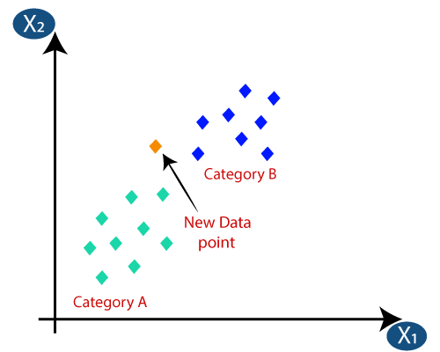
Suppose we have a new data point and we need to put it in the required category. Consider the below image:

Slide 52
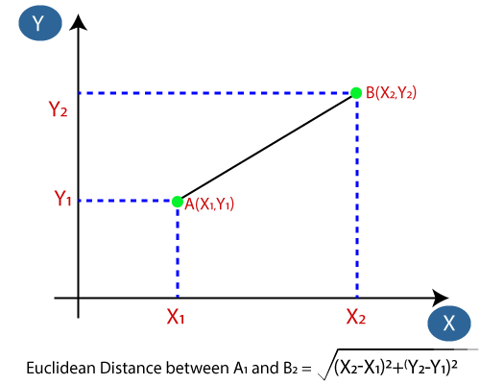
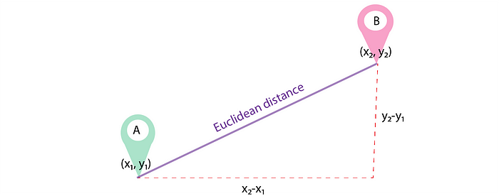
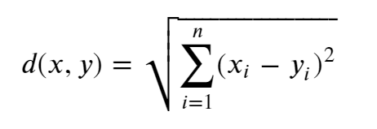
Euclidean Distance
Firstly, we will choose the number of neighbors, so we will choose the k=5.
Next, we will calculate the Euclidean distance between the data points. The Euclidean distance is the distance between two points, which we have already studied in geometry. It can be calculated as given.
The equation at the heart of this distance is the
Pythagorean theorem!: 𝑎2+𝑏2=𝑐2.
The formula to calculate Euclidean distance is:

Slide 53
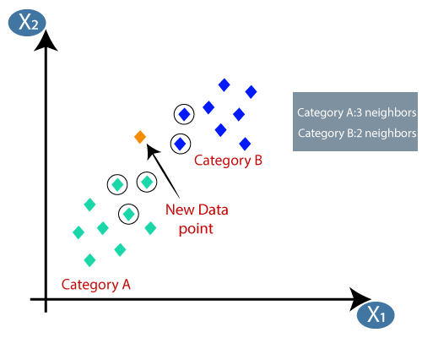
https://www.omnicalculator.com/math/euclidean-distance
By calculating the Euclidean distance we got the nearest neighbors, as three nearest neighbors in category A and two nearest neighbors in category B. Consider the below image:

Slide 54
Naive Bayes Classification
Naive Bayes Classification
Suppose you are a product manager, you want to classify customer reviews in positive and negative classes. Or As a loan manager, you want to identify which loan applicants are safe or risky?
As a healthcare analyst, you want to predict which patients can suffer from diabetes disease. All the examples have the same kind of problem to classify reviews, loan applicants, and patients.
Naive Bayes is the most straightforward and fast classification algorithm, which is suitable for a large chunk of data. Naive Bayes classifier is successfully used in various applications such as spam filtering, text classification, sentiment analysis, and recommender systems.
It uses Bayes theorem of probability for prediction of unknown class.

Slide 55
Naive Bayes Classification
What is Naive Bayes Classifier?
Naive Bayes is a statistical classification technique based on Bayes Theorem. Naive Bayes classifier is the fast, accurate and reliable algorithm. Naive Bayes classifiers have high accuracy and speed on large datasets.
Naive Bayes classifier assumes that the effect of a particular feature in a class is independent of other features. For example, a loan applicant is desirable or not depending on his/her income, previous loan and transaction history, age, and location. Even if these features are interdependent, these features are still considered independently. This assumption simplifies computation, and that's why it is considered as naive. This assumption is called class conditional independence.

Slide 56

Naive Bayes Classification
P(h): the probability of hypothesis h being true (regardless of the data). This is known as the prior probability of h.
P(D): the probability of the data (regardless of the hypothesis). This is known as the prior probability.
P(h|D): the probability of hypothesis h given the data D. This is known as posterior probability.
P(D|h): the probability of data d given that the hypothesis h was true. This is known as posterior probability.

Slide 57
How Naive Bayes Classifier Works?
How Naive Bayes Classifier Works?
Given an example of weather conditions and playing sports. You need to calculate the probability of playing sports. Now, you need to classify whether players will play or not, based on the weather condition.
Step 1: Calculate the prior probability for given class labels
Step 2: Find Likelihood probability with each attribute for each class
Step 3: Put these value in Bayes Formula and calculate posterior probability.
Step 4: See which class has a higher probability, given the input belongs to the higher probability class.

Slide 58
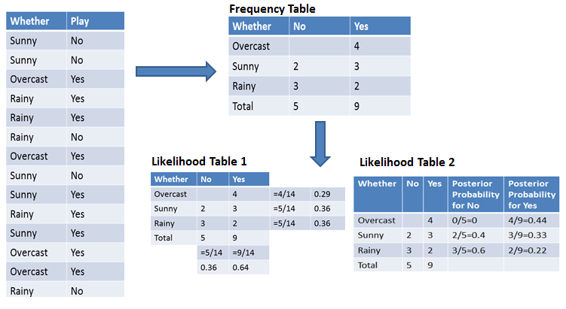
How Naive Bayes Classifier Works?
For simplifying prior & posterior probability calculation, you can use 2 tables frequency & likelihood tables. Both of these tables will help you to calculate the prior & posterior probability. The Frequency table contains the occurrence of labels for all features. There are 2 likelihood tables. Likelihood Table 1 is showing prior probabilities of labels & Likelihood Table 2 is showing the posterior probability.

Slide 59
Now suppose you want to calculate the probability of playing when the weather is overcast.
Probability of playing:
P(Yes | Overcast) = P(Overcast | Yes) P(Yes) / P (Overcast) .....................(1)
Calculate Prior Probabilities:
P(Overcast) = 4/14 = 0.29
P(Yes)= 9/14 = 0.64
Calculate Posterior Probabilities:
P(Overcast |Yes) = 4/9 = 0.44
Put Prior and Posterior probabilities in equation (1)
P (Yes | Overcast) = 0.44 * 0.64 / 0.29 = 0.98(Higher)
Similarly, you can calculate the probability of not playing:

Slide 60
Probability of not playing:
P(No | Overcast) = P(Overcast | No) P(No) / P (Overcast) .....................(2)
Calculate Prior Probabilities:
P(Overcast) = 4/14 = 0.29
P(No)= 5/14 = 0.36
Calculate Posterior Probabilities:
P(Overcast |No) = 0/9 = 0
Put Prior and Posterior probabilities in equation (2)
P (No | Overcast) = 0 * 0.36 / 0.29 = 0
The probability of a 'Yes' class is higher. So you can determine here if the weather is overcast than players will play the sport.

Slide 61
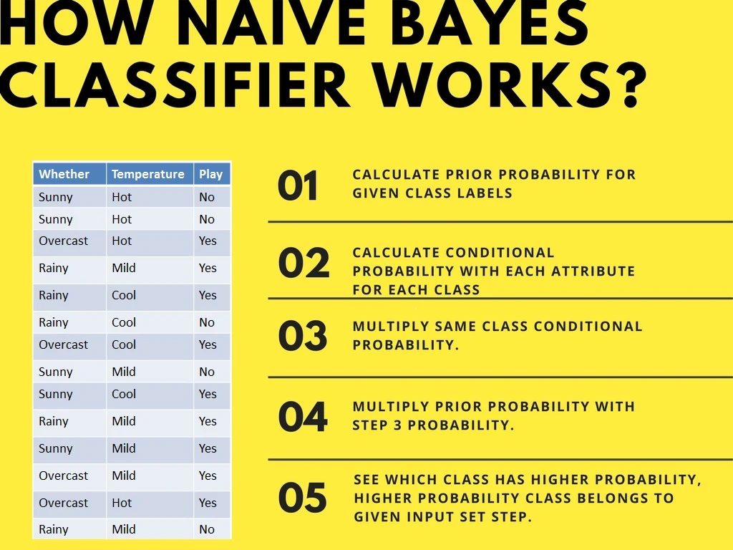
Second Approach (In case of multiple features)

Slide 62
Now suppose you want to calculate the probability of playing when the weather is overcast, and the temperature is mild.
Probability of playing:
P(Play= Yes | Weather=Overcast, Temp=Mild) = P(Weather=Overcast, Temp=Mild | Play= Yes)P(Play=Yes) ..........(1)
P(Weather=Overcast, Temp=Mild | Play= Yes)= P(Overcast |Yes) P(Mild |Yes) ………..(2)
Calculate Prior Probabilities: P(Yes)= 9/14 = 0.64
Calculate Posterior Probabilities: P(Overcast |Yes) = 4/9 = 0.44 P(Mild |Yes) = 4/9 = 0.44
Put Posterior probabilities in equation (2) P(Weather=Overcast, Temp=Mild | Play= Yes) = 0.44 * 0.44 = 0.1936(Higher)
Put Prior and Posterior probabilities in equation (1) P(Play= Yes | Weather=Overcast, Temp=Mild) = 0.1936*0.64 = 0.124
Notes:
https://www.datacamp.com/tutorial/naive-bayes-scikit-learn

Slide 63
Probability of not playing:
P(Play= No | Weather=Overcast, Temp=Mild) = P(Weather=Overcast, Temp=Mild | Play= No)P(Play=No) ..........(3)
P(Weather=Overcast, Temp=Mild | Play= No)= P(Weather=Overcast |Play=No) P(Temp=Mild | Play=No) ………..(4)
Calculate Prior Probabilities: P(No)= 5/14 = 0.36
Calculate Posterior Probabilities: P(Weather=Overcast |Play=No) = 0/9 = 0 P(Temp=Mild | Play=No)=2/5=0.4
Put posterior probabilities in equation (4) P(Weather=Overcast, Temp=Mild | Play= No) = 0 * 0.4= 0
Put prior and posterior probabilities in equation (3) P(Play= No | Weather=Overcast, Temp=Mild) = 0*0.36=0
The probability of a 'Yes' class is higher. So you can say here that if the weather is overcast than players will play the sport.

Slide 64
Support Vector Machine Algorithm
Support Vector Machine Algorithm
Support Vector Machine or SVM is one of the most popular Supervised Learning algorithms, which is used for Classification as well as Regression problems. However, primarily, it is used for Classification problems in Machine Learning.
The goal of the SVM algorithm is to create the best line or decision boundary that can segregate n-dimensional space into classes so that we can easily put the new data point in the correct category in the future. This best decision boundary is called a hyperplane.

Slide 65
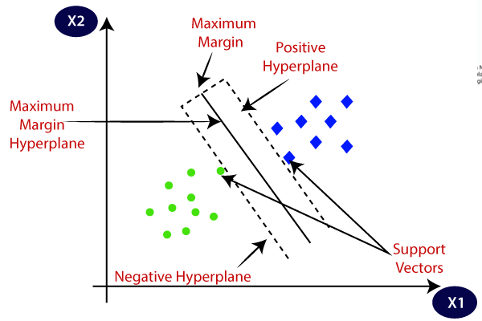
Support Vector Machine - HyperPlane
Hyperplane
SVM chooses the extreme points/vectors that help in creating the hyperplane. These extreme cases are called as support vectors, and hence algorithm is termed as Support Vector Machine. Consider the below diagram in which there are two different categories that are classified using a decision boundary or hyperplane:

Slide 66
Example.
SVM can be understood with the example that we have used in the KNN classifier. Suppose we see a strange cat that also has some features of dogs, so if we want a model that can accurately identify whether it is a cat or dog, so such a model can be created by using the SVM algorithm.
We will first train our model with lots of images of cats and dogs so that it can learn about different features of cats and dogs, and then we test it with this strange creature.
So as support vector creates a decision boundary between these two data (cat and dog) and choose extreme cases (support vectors), it will see the extreme case of cat and dog. On the basis of the support vectors, it will classify it as a cat. Consider the below diagram:

Slide 67
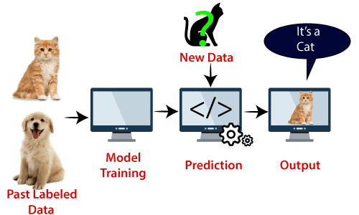
SVM algorithm can be used for Face detection, image classification, text categorization, etc.

Slide 68
Types of SVM
Types of SVM
Linear SVM: Linear SVM is used for linearly separable data, which means if a dataset can be classified into two classes by using a single straight line, then such data is termed as linearly separable data, and classifier is used called as Linear SVM classifier.
Non-linear SVM: Non-Linear SVM is used for non-linearly separated data, which means if a dataset cannot be classified by using a straight line, then such data is termed as non-linear data and classifier used is called as Non-linear SVM classifier.

Slide 69
Hyperplane & Support Vectors in the SVM algo:
Hyperplane & Support Vectors in the SVM algo:
Hyperplane: There can be multiple lines/decision boundaries to segregate the classes in n-dimensional space, but we need to find out the best decision boundary that helps to classify the data points. This best boundary is known as the hyperplane of SVM.
The dimensions of the hyperplane depend on the features present in the dataset, which means if there are 2 features (as shown in image), then hyperplane will be a straight line. And if there are 3 features, then hyperplane will be a 2-dimension plane.
We always create a hyperplane that has a maximum margin, which means the maximum distance between the data points.

Slide 70
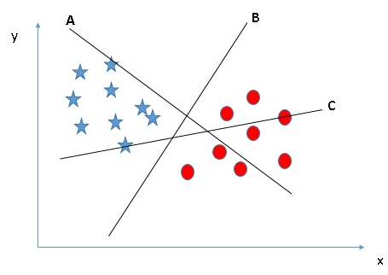
How does Support Vector Machine Work?
How Does a Support Vector Machine / SVM Work?
Identify the right hyper-plane (Scenario-1): Here, we have three hyper-planes (A, B, and C). Now, identify the right hyper-plane to classify stars and circles.
You need to remember a thumb rule to identify the right hyper-plane: “Select the hyper-plane which segregates the two classes better.” In this scenario, hyper-plane “B” has excellently performed this job.

Slide 71
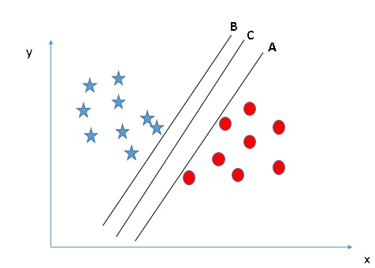
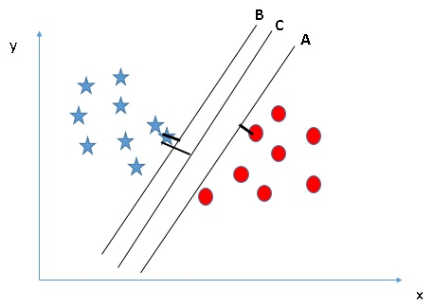
Identify the right hyper-plane (Scenario-2): Here, we have three hyper-planes (A, B, and C), and all segregate the classes well. Now, How can we identify the right hyper-plane?
You can see that the margin for hyper-plane C is high as compared to both A and B. Hence, we name the right hyper-plane as C. Another lightning reason for selecting the hyper-plane with a higher margin is robustness. If we select a hyper-plane having a low margin, then there is a high chance of misclassification.
Here, maximizing the distances between the nearest data point (either class) and the hyper-plane will help us to decide the right hyper-plane. This distance is called a Margin.

